Slide 1
BIAPT Lab Meeting
Work in Progress
Wednesday, February 24th

Slide 2
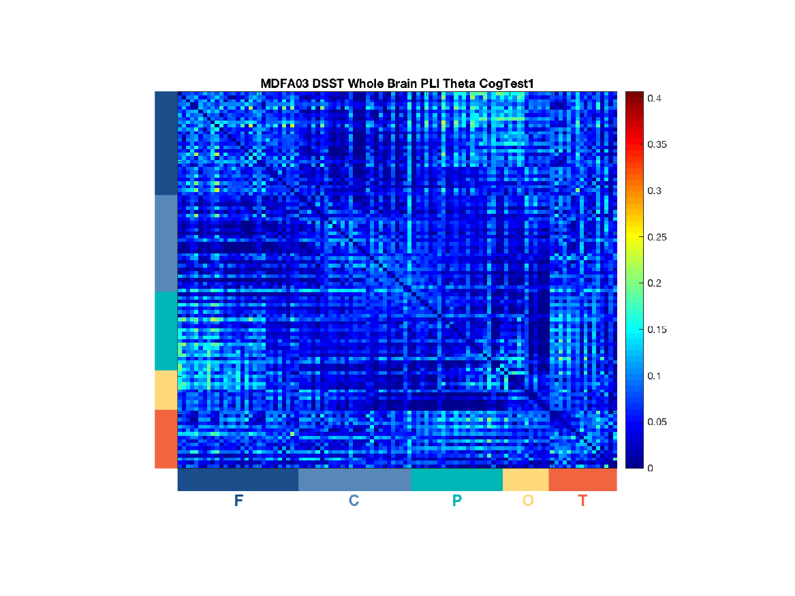

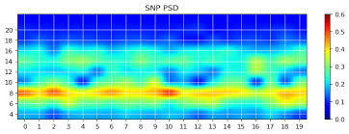
Research Line 1: To use electroencephalography (EEG) to elucidate novel biomarkers of concussion and understand the electrophysiological basis of clinical impairments.
Notes:
Concussion diagnosis and management is currently focused on clinical assessment, particularly computerized neurocognitive testing.
Little physiological data used
Relationships between physiological data and clinical outcomes largely unexplored
Spectral EEG analyses quantify the oscillatory power of the brain’s electrical activity across varying frequencies.
-Spectral deficits observed post-concussion
-Major of rs-EEG literature in concussion use spectral analysis
Functional connectivity may be a better outcomes
-Diffuse axonal injury- connectivity may more precisely measure disrupted neural communication
-Research suggests functional connectivity markers are altered post-concussion¹⁹⁻²¹ and are a larger contributor to a proprietary concussion classification algorithm than spectral markers.^{22,23}
Came to Stefanie to learn new EEG skills, that I can then take back to individuals with concussion

Slide 3
The Reconstructing Consciousness and Cognition (ReCCognition) Study sought to measure the sequence of cognitive recovery following emergence from anesthesia. .
Maier et al. 2017; Rokos et al.
Notes:
3 locations (Michigan, UPenn, Washington University in St. Louis
Participants were randomized to anesthesia received propofal and were under anesthetics for 3 hours
Control group received no intervention, but were required to remain awake during 3 hours block (TV read)
In total, 15 participants (9 anesthesia, 6 controls) were available to be used

Slide 4
A modified version of the Cognition Test Battery for Spaceflight was administered at all eight sessions.
Maier et al. 2017; Rokos et al.
Notes:
3 locations (Michigan, UPenn, Washington University in St. Louis
Participants were randomized to anesthesia received propofal and were under anesthetics for 3 hours
Control group received no intervention, but were required to remain awake during 3 hours block (TV read)
In total, 15 participants (9 anesthesia, 6 controls) were available to be used

Slide 5
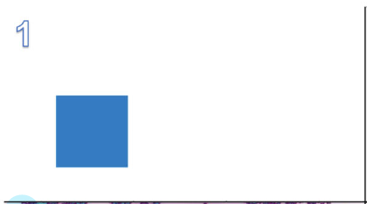
Motor Praxis
Domain: sensorimotor speed
Click on squares randomly appearing on screen
Each successive square gets smaller
20 squares in each session
Basner et al. 2015

Slide 6
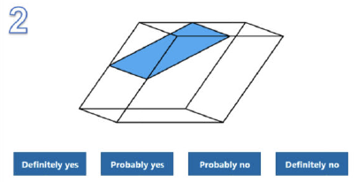
Visual Object Learning Test
Domain: memory
10 3D figures are sequentially displayed
Memorize
Recall 10 target figures from a set of 20
Basner et al. 2015

Slide 7
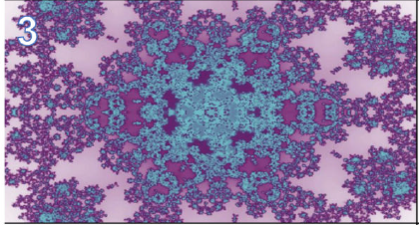
Fractal N-Back (2-Back)
Domain: working memory
Images presented sequentially every 750ms
Respond when image is the same as image displayed two times ago
62 images per session
6
4
6
2
1
2
5
Basner et al. 2015

Slide 8
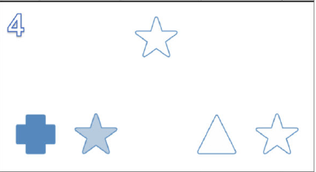
Abstract Matching
Domain: executive function
Two pairs of objects at the bottom, varied on color and dimension
Target object presented in the middle
Classify based on rules provided
Basner et al. 2015

Slide 9
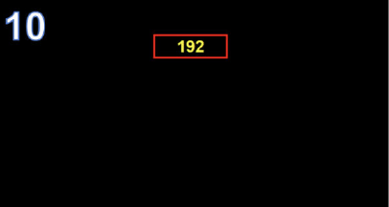
Psychomotor Vigilance Test
Domain: vigilant attention
Timer randomly appears and starts counting
Hit space bar as quickly as possible
Test lasts for 3 minutes
Basner et al. 2015

Slide 10
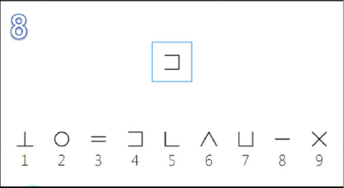
Digit Symbol Substitution Test
Domain: working memory, visual search
Symbol appears on screen
Use legend at bottom to select corresponding number
As many symbols as possible in 90 seconds
Basner et al. 2015

Slide 11
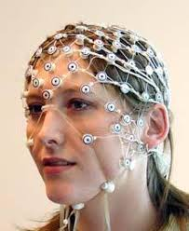

Subjects were fitted with high-density EEG (128 electrodes) throughout the entire study period.
Maier et al. 2017
Notes:
For our study, we focused on the EEG recorded during all six cognitive tests, over the 8 administrations

Slide 12
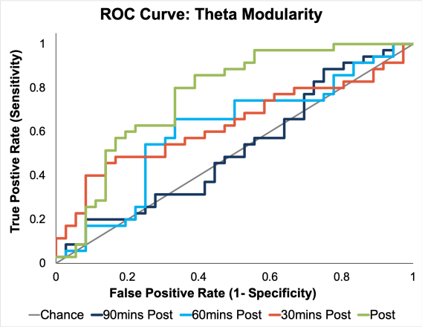
Can graph theory features accurately classify the recovery of cognition in adults following an experimental anesthesia protocol compared to healthy controls?
Graph theory metrics: path length, modularity, clustering coefficient, global efficiency
Frequency bands: theta, alpha, beta
Receiver operating curve analyses
Data set too small for machine learning
Notes:
Theta modularity maximally classified between the anesthesia and control groups immediately post-intervention (sensitivity= 85.7%; specificity= 61.1%; AUC= 0.72; χ²₍₁₎=12.21; p<0.001; Figure 1). AUC decreased over time and returned to baseline levels (AUC=0.54) by 90mins post-intervention.

Slide 13
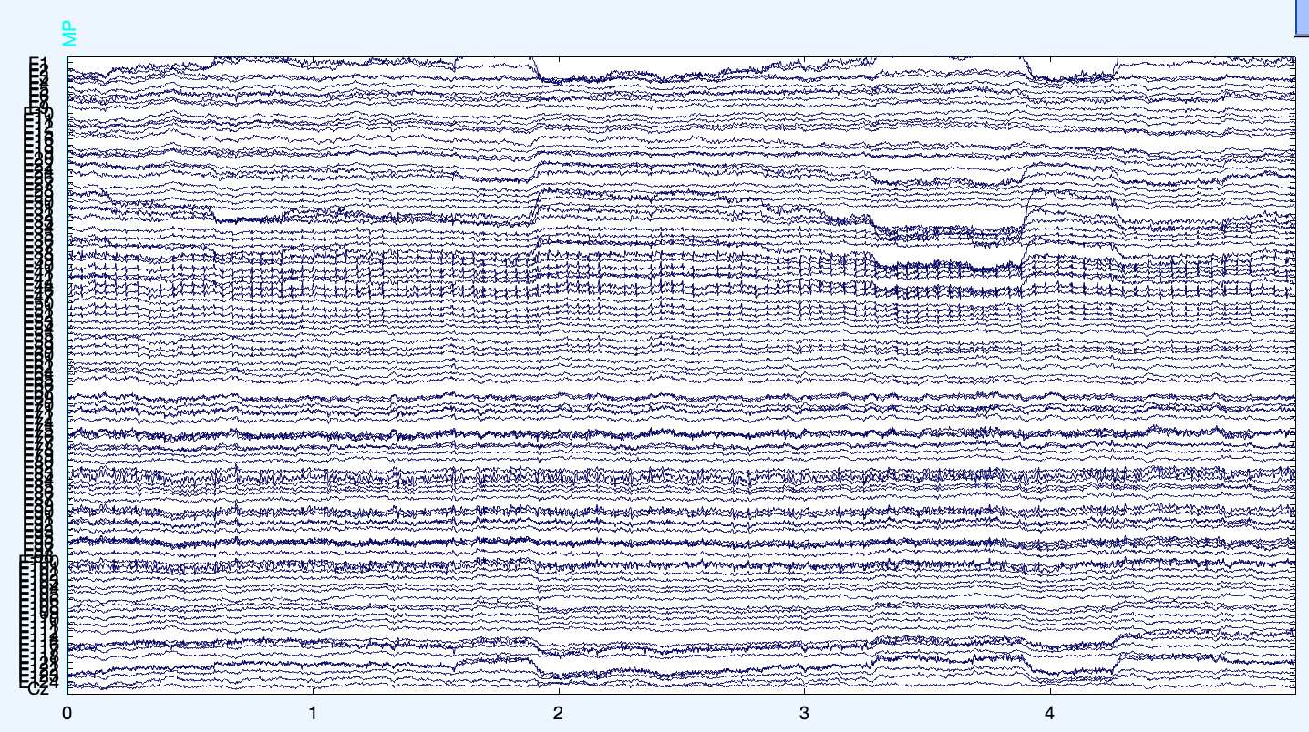
Step 1: Pre-process the data in EEGlab
Data already cleaned
Load dataset
Add channel locations
Removed non-scalp channels
Not aware there was code to filter these channels out later
Add start/stop times for each cognitive test
Epoch data
5 seconds after test start to test end
Save epoch as .mat file
Notes:
5 seconds after- start time was was when test began, but there are directions
5 seconds was conservation estimate that we were using data collected during the test only, not the direction

Slide 14
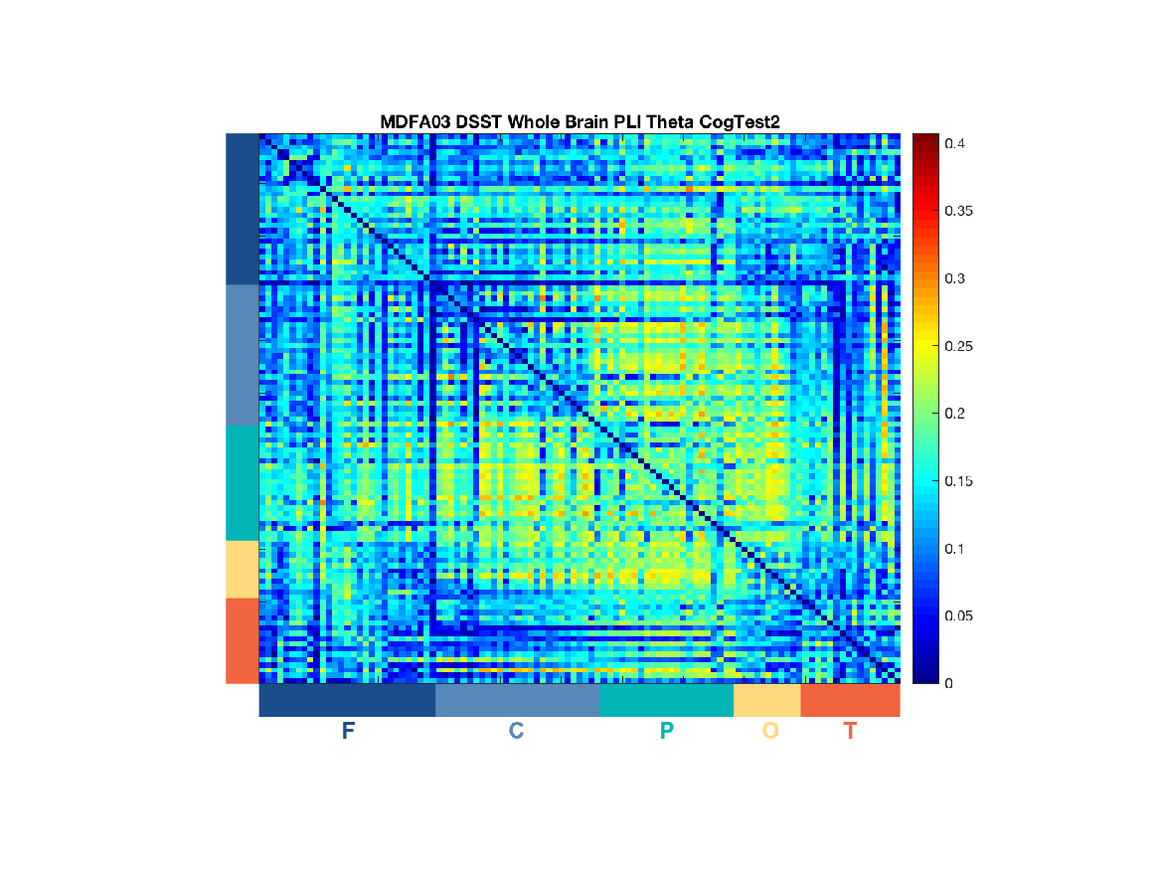
Step 2: Run wPLI analysis
Analysis run in EEGApp
Parameters
Length of segment: 10
Number of permutations: 20
P value: 0.05
Bandpass
Delta: 1-4Hz
Theta: 4-8Hz
Alpha: 8-13Hz
Beta: 13-30Hz
Electrode order updated
Baseline
Immediately Post-Anesthesia
Notes:
dPLI was also conducted, but graph theory is based on wPLI so that’s what I’m focusing on

Slide 15
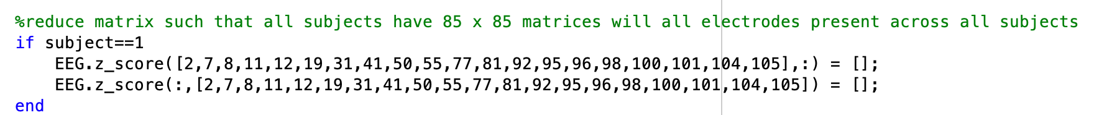
Step 3: Sweep data to determine threshold
Reduce matrix to 85x85
Channels available across all 15 participants
Threshold sweep
Minimally spanning map
0.90-0.01 by 0.01 steps
Average data
Mean from all six cognitive tests from the first administration (baseline)
Thresholds calculated separately for each frequency band

Slide 16
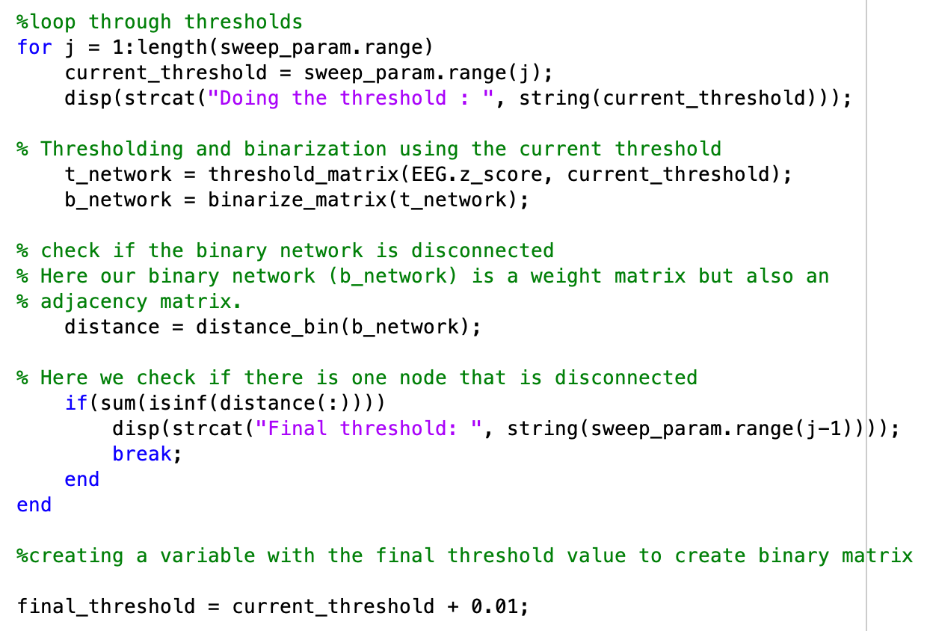

Slide 17
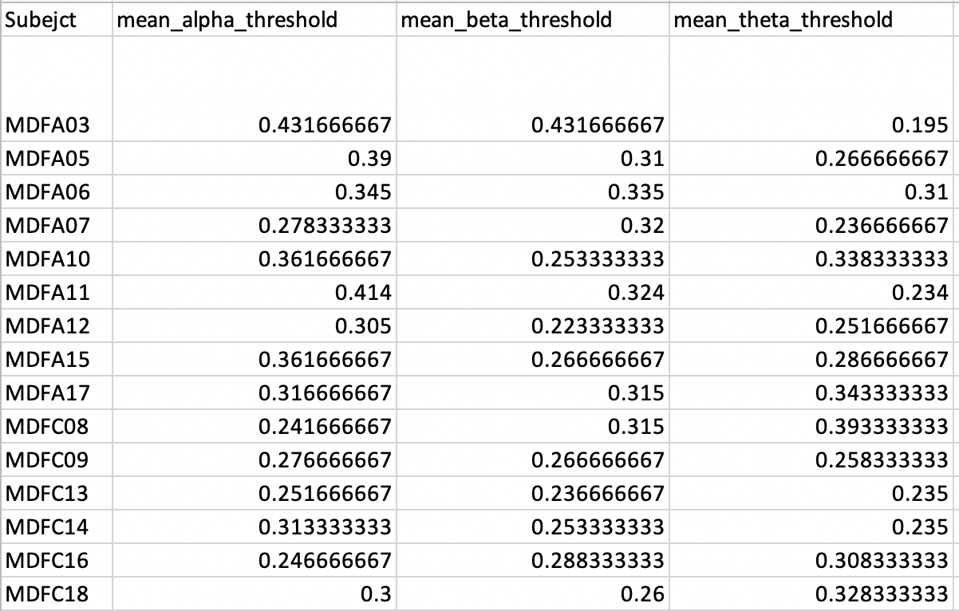

Slide 18
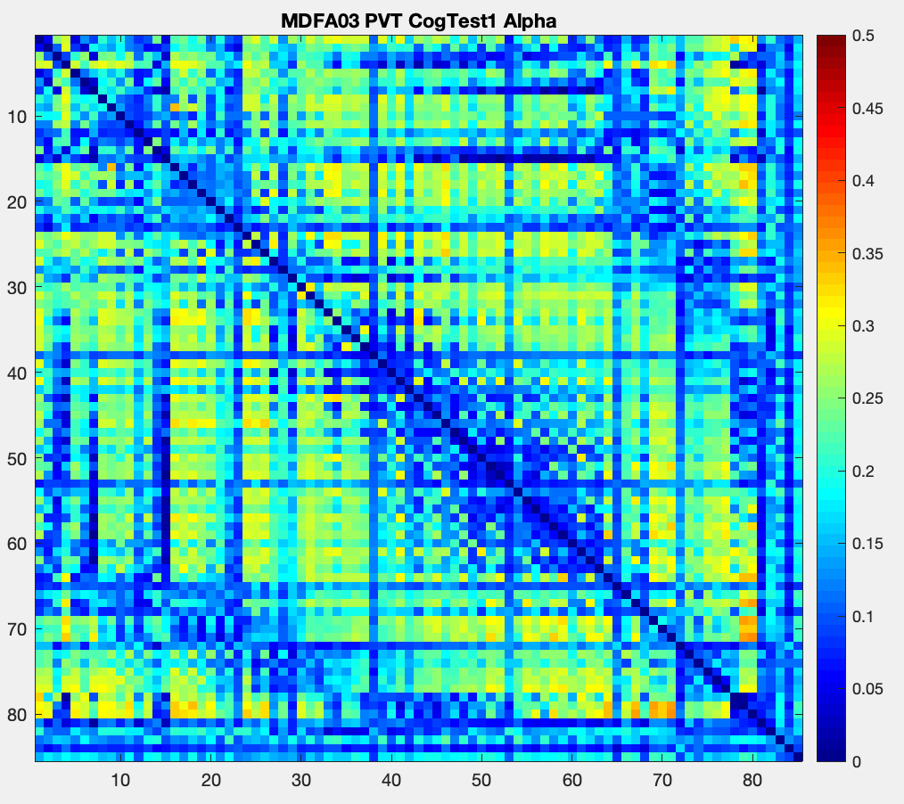
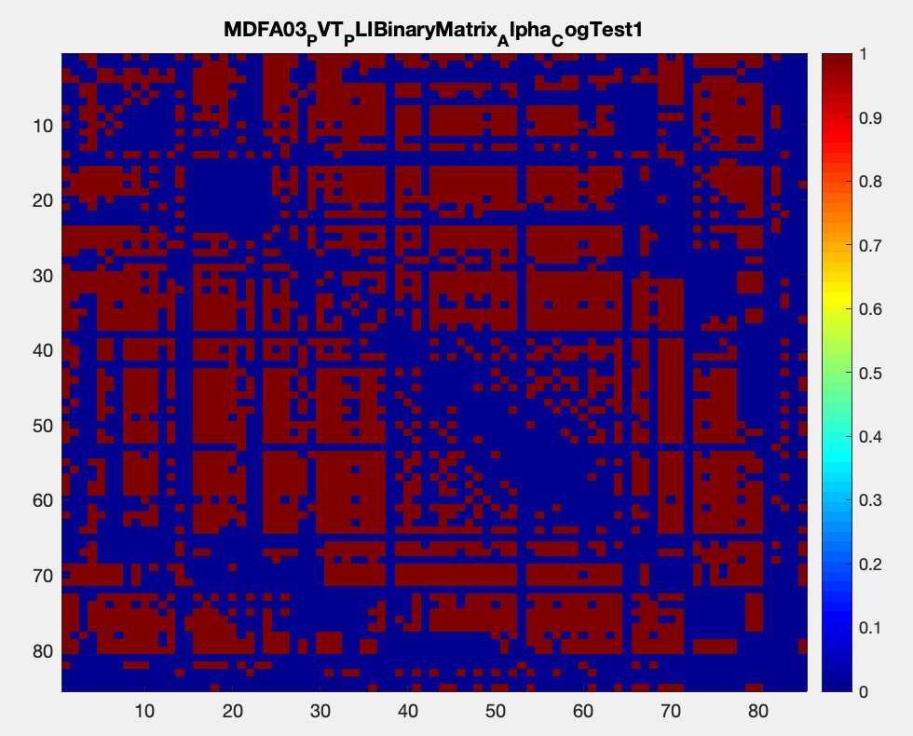
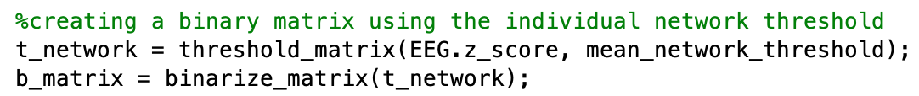
Step 4: Create a binary matrix
Applied individual network threshold
wPLI values > threshold = 1
I.e. Threshold = 0.20, wPLI in top 20% of data were set to 1
Otherwise, binary matrix= 0

Slide 19
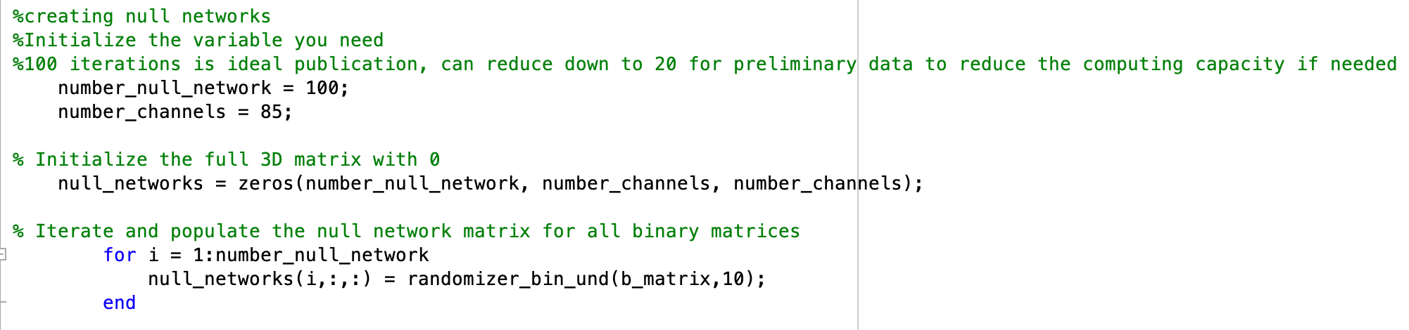
Step 5: Create null networks/random networks
Parameters
Function: randomizer_bin_und.m
Fraction of edges to rewire: 10%
Number of null networks created: 100

Slide 20
Step 6: Calculate global efficiency (and other variables)
Load binary network and null networks
Code: binary_global_efficinecy.m

Slide 21
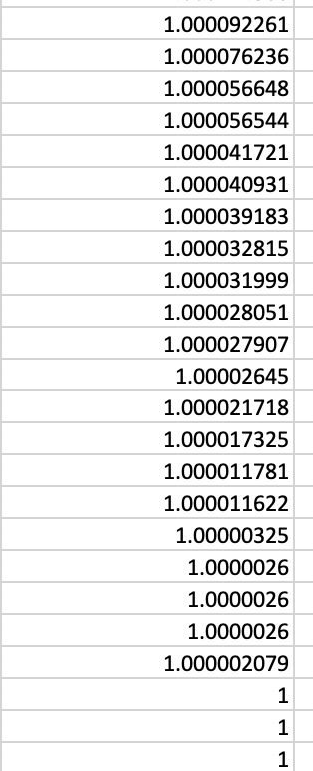
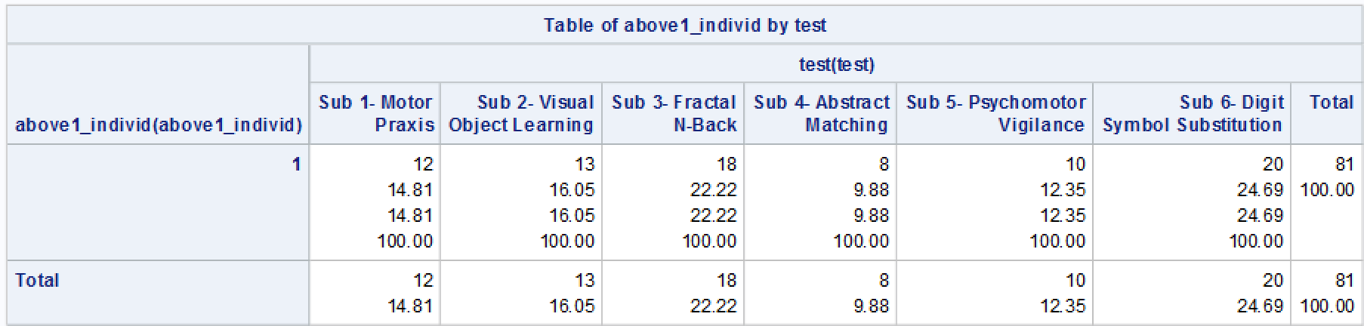
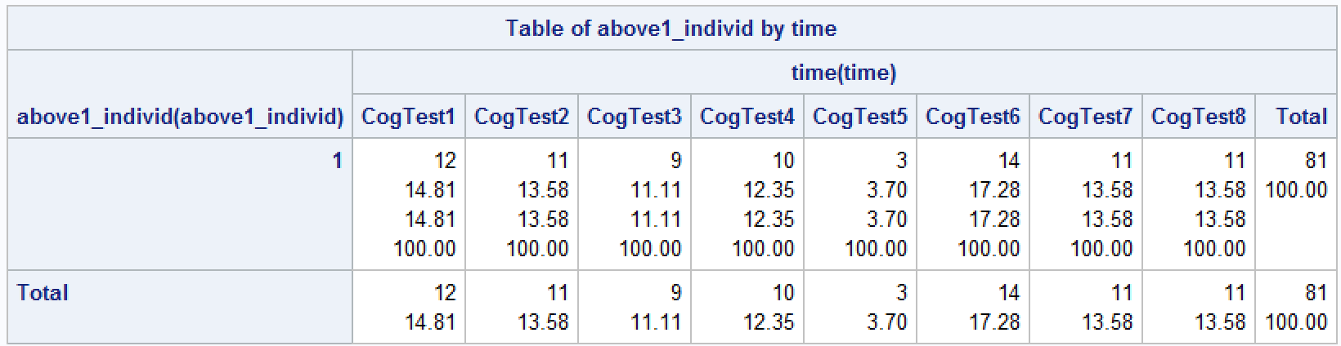
The problem: roughly 5% of global efficiency values are above 1; this is theoretically not possible.
Notes:
81 (out of 2074- roughly 5%) global efficiency outcomes are greater than 1
-19 of the 81 are 1.01 or greater
-0 are greater than 1.1
All other outcomes (path length, clustering characteristics, small-worldness)
SAS- get freq/percentages about number of participants with outcomes greater than 1, 1.01
Participants
Cognitive test
Time (cogtest 1, cogtest 2, etc.)

Slide 22
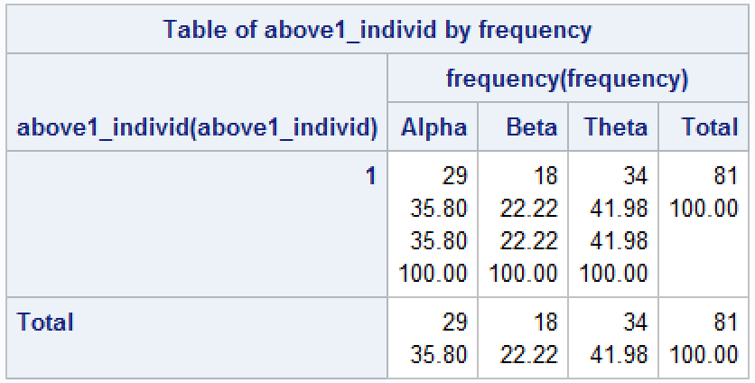
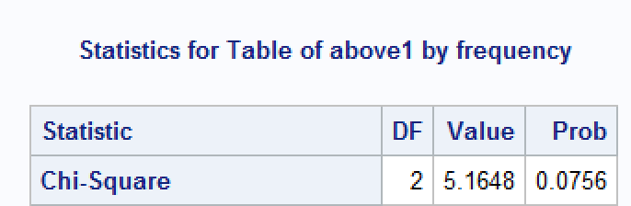
Efficiency values ≥ 1 appear to be less common in the beta frequency band compared to alpha and theta.

Slide 23
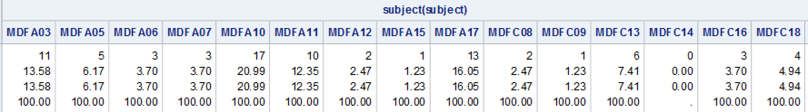
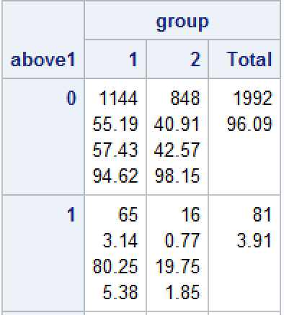
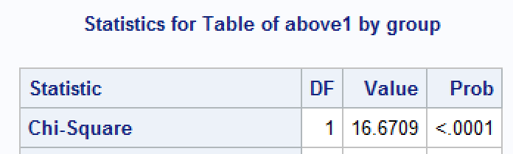
Global efficiency values above 1 are more common in the anesthesia group, although every participant but one has at least one efficiency values ≥ 1.

Slide 24
Things I have (unsuccessfully) tried to resolve this issue:
Null network code
Different functions
Adjusting parameters within a function
Global efficiency code
Network threshold
Individual vs. constant values
Re-running the analysis
Generating wPLI matrices via code
Notes:
Note: only tried these work arounds a subset of the data, but as it didn’t resolve issues in the subset I didn’t both re-running data in the full set

Slide 25
Things I have (unsuccessfully) tried to resolve this issue:
Null Network Code
Different functions
Adjusting parameters within a function
Global efficiency code
Network Threshold
Individual vs. constant values
Re-running the analysis
Generating wPLI matrices via code
Notes:
Note: only tried these work arounds a subset of the data, but as it didn’t resolve issues in the subset I didn’t both re-running data in the full set

Slide 26
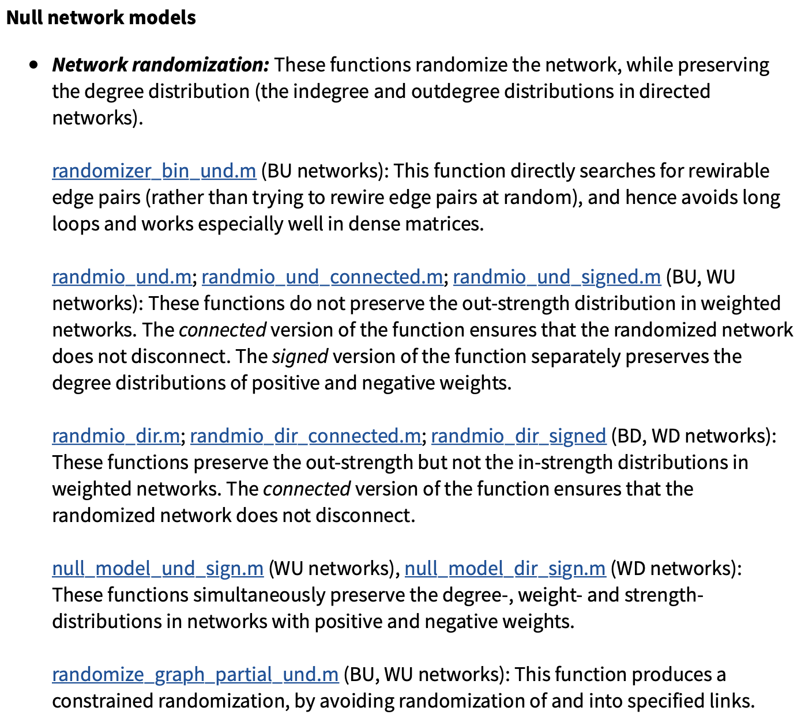
Using different null network codes did not produce any meaningful changes.

Slide 27
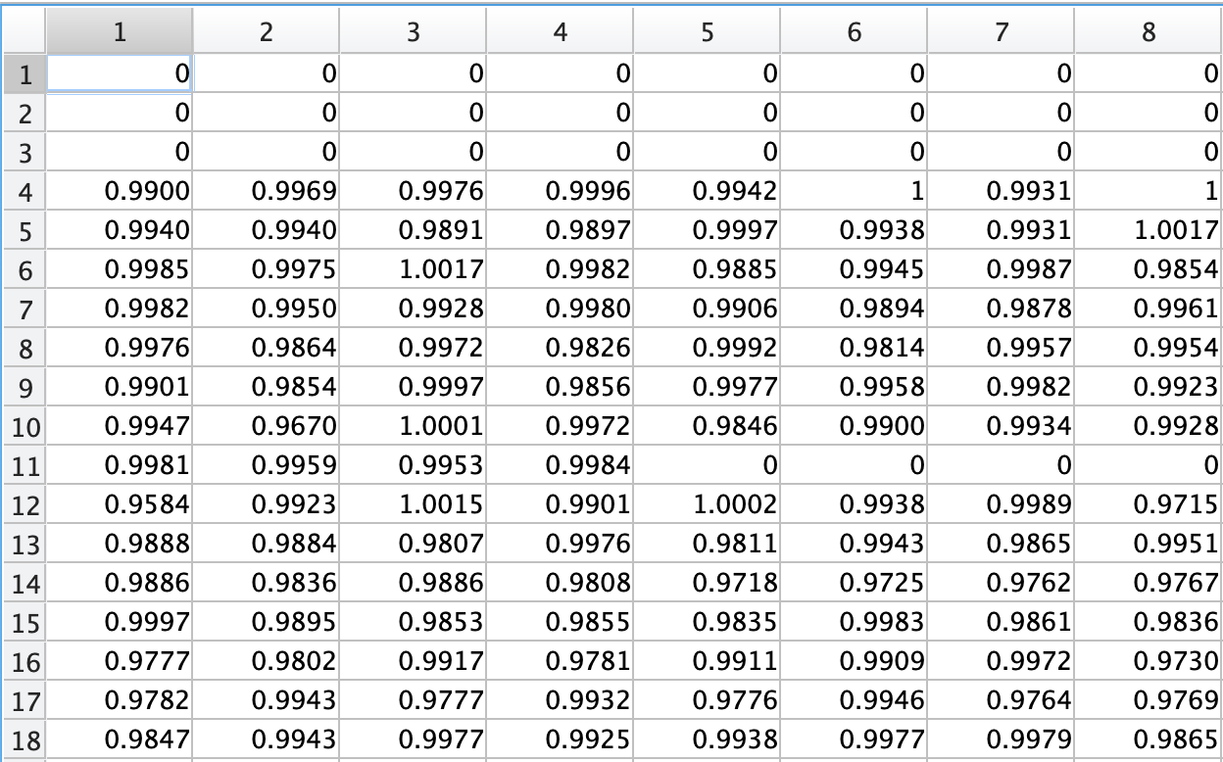
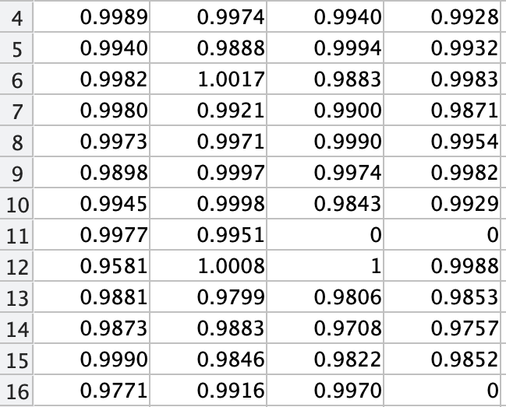
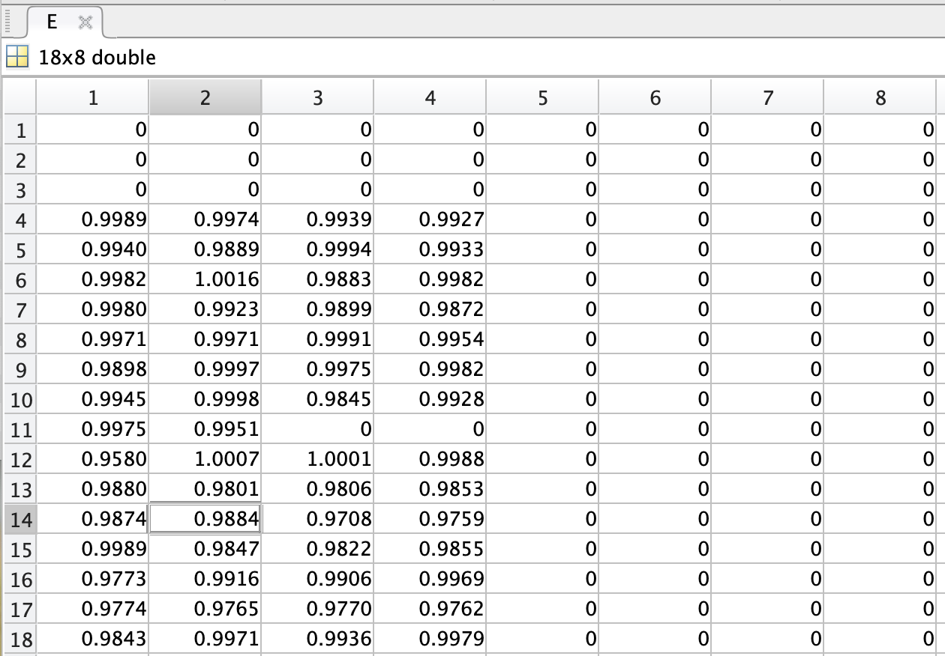
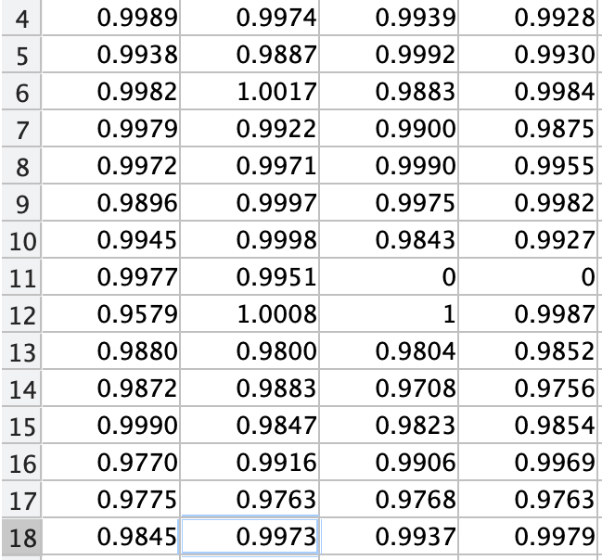
For the most part, global efficiency values remained above one regardless of which null network code was utilized.
Null_model_und_sign
Randmio_dir_connected
Changes to global efficiency values were extremely small regardless of which function was used.
Null_model_dir_sign
Randmio_dir_sign

Slide 28
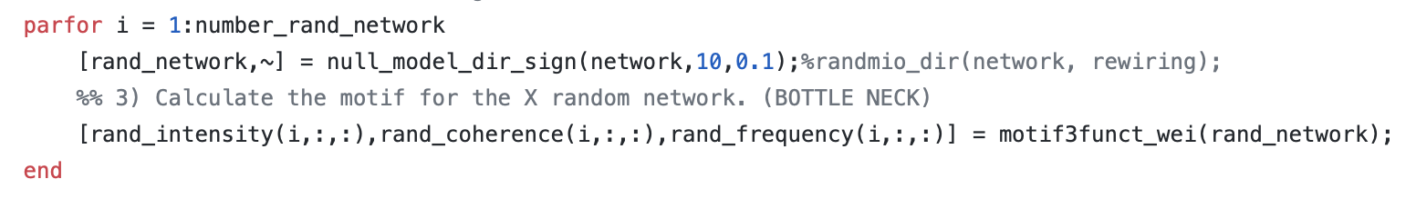
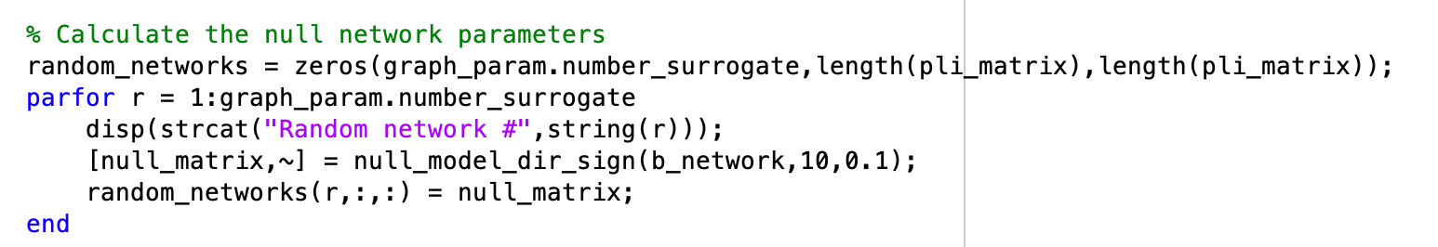
Danielle’s code from Motif Paper
My code
Notes:
https://github.com/BIAPT/EEGMotifs/blob/master/src/features/calculate_validated_motifs.m

Slide 29
Things I have (unsuccessfully) tried to resolve this issue:
Null Network Code
Different functions
Adjusting parameters within a function
Global efficiency code
Network Threshold
Individual vs. constant values
Re-running the analysis
Generating wPLI matrices via code
Notes:
Note: only tried these work arounds a subset of the data, but as it didn’t resolve issues in the subset I didn’t both re-running data in the full set

Slide 30
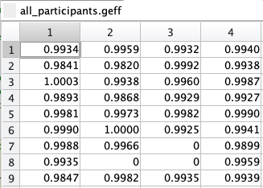
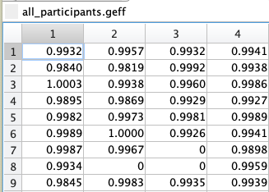
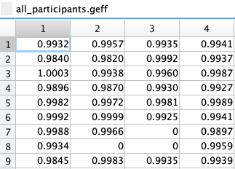
Altering the fraction of edges to rewire provided no meaningful difference.
5%
10%
20%
Notes:
Random_bin_und
Individual threholds

Slide 31
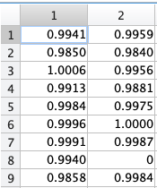
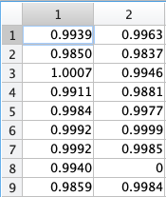
Frequency of weight sorting in null_dir_sign.m also did not appear to make a meaningful difference.
0.1
0.25
Notes:
10% rewiring kept throught
Random_bin_und

Slide 32
Changing the number of null networks generally reduces the global efficiency values, but some cells are still above 1.
100
10
Notes:
Original told that for pubs, you want 100+ null networks
Danielle’s code only uses 10 null networks

Slide 33
Things I have (unsuccessfully) tried to resolve this issue:
Null Network Code
Different functions
Adjusting parameters within a function
Global efficiency code
Network Threshold
Individual vs. constant values
Re-running the analysis
Generating wPLI matrices via code
Notes:
Note: only tried these work arounds a subset of the data, but as it didn’t resolve issues in the subset I didn’t both re-running data in the full set

Slide 34
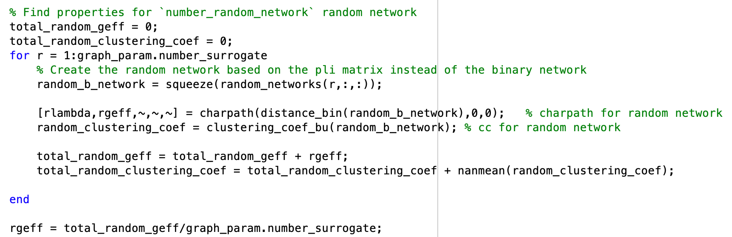
Danielle’s code from AEC
Yacine’s Matlab function

Slide 35
Things I have (unsuccessfully) tried to resolve this issue:
Null Network Code
Different functions
Adjusting parameters within a function
Global efficiency code
Network Threshold
Individual vs. constant values
Re-running the analysis
Generating wPLI matrices via code
Notes:
Note: only tried these work arounds a subset of the data, but as it didn’t resolve issues in the subset I didn’t both re-running data in the full set

Slide 36
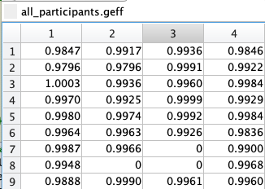
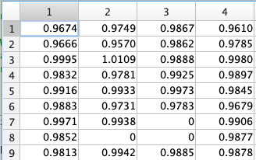
Altering the threshold value moved some global efficiency values to under 1, but increased other values over 1.
Individual
35%
25%
Notes:
10% rewiring kept throught
Random_bin_und

Slide 37
Things I have (unsuccessfully) tried to resolve this issue:
Null Network Code
Different functions
Adjusting parameters within a function
Global efficiency code
Network Threshold
Individual vs. constant values
Re-running the analysis
Generating wPLI matrices via code
Notes:
Note: only tried these work arounds a subset of the data, but as it didn’t resolve issues in the subset I didn’t both re-running data in the full set

Slide 38
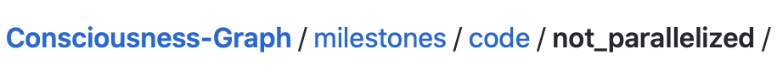
Step 1: Pre-process data
Step 2: Run wPLI analysis
Step 3: Threshold Sweep
Step 4: Create binary matrix
Step 5: Create null networks
Step 6: Calculate global efficiency
Changes made:
wPLI step size: 1 to 10
Threshold: 0.3 to individual value

Slide 39
Potential reasons for problems
Data recording during cognitive tasks?
(I think) Other data from MDF data is from resting-state conditions
Same issue on DSI-24 which was collected during resting state
Removed non-scalp electrodes while cleaning in EEGlab?
Those electrodes get filtered out anyway
Bad channels removed in resting-state data which works
Same issue on DSI-24 data with only one bad channel removed
Issues with reduced 85x85 channel PLI matrix?
Re-running the analysis: used all available channels for each participant and issue remains
Some sort of statistical anomaly/rounding error?

Slide 40
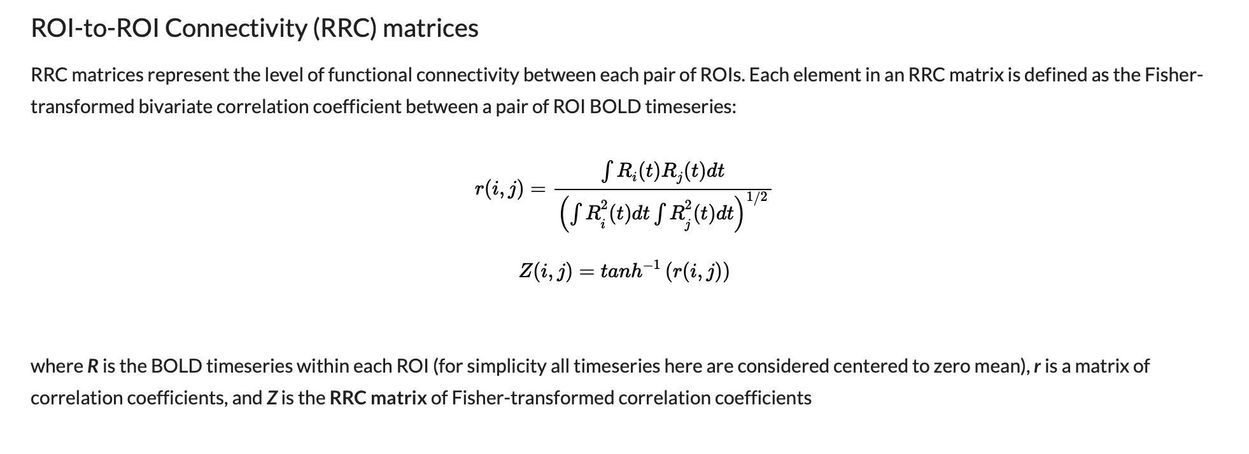
Notes:
Resting state fMRI data
-ROI to ROI connectivity matrix with a Fischer’s transform
-due to the complex math and transformations, they get values over 1 even though they theoretically shouldn’t
-All values in question for were ~1.0039 etc. so kind of negligible decimal values and very close to 1 so he said it was ok to keep them bc the decimal stuff was just bc of all the math
Everyone else has been able to resolve the issue

Slide 41


Any thoughts or suggestions? Did you notice any errors in the code?
Notes:
Thoughts? Suggestions? Errors

